Slide 1





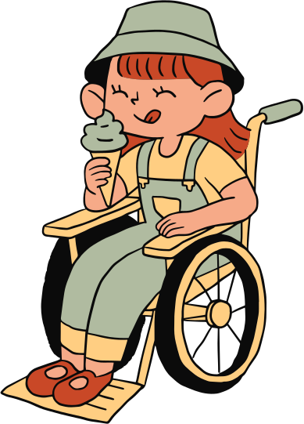




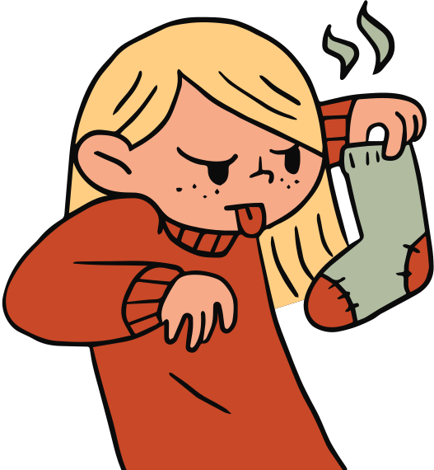

LIBRARY
MANAGEMENT
By: Udit Kumar

Slide 2
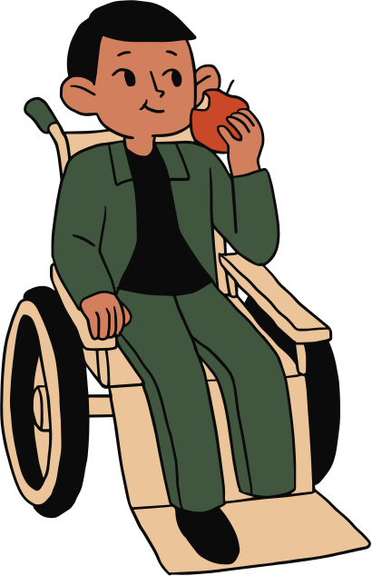
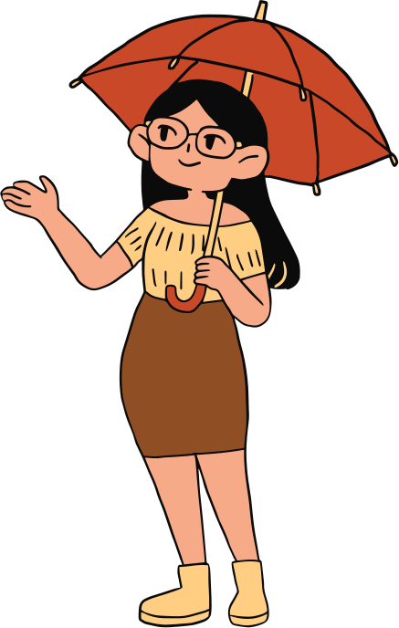
AIM:
To Develop Library Management System
Develop a software named Library Management System to
manage manual functions of a library. The software should helps to
manage the entire library operations from maintaining book records to
issue a book. In addition, it should allows streamlined management of
fine details of books such as author name, costing, number of copies
existing in the library and many other important details. Make it easier
to search for books and find the right materials for students and the
librarian instantly.

Slide 3

Why i chose this topic?
To reduce the manual work to manage library functions.
To Save time and reduced overheads.
To increase Librarian's efficiencies.
To remove manual processes in the Library.
To perform day to day library operations electronically.

Slide 4

Introduction
LMS is also called an automated library system. It is
defined as software that has been established to manage
basic housekeeping function of a library.
The electronic management via the software is essential to track
information like issue date, due date, who has borrowed any book etc.
The system is developed and designed with an aim to facilitate efficient
management to the schools to manage a modern library with accurate
data management. The software is intended to reduce the manual work
to manage library functions which have various features.

Slide 5
FUNCTIONS
In order to maintain library management software, LMS has the
following set of components. These components are efficient to manage
library operations accurately.
LIBRARY

Slide 6
Add and update books: LMS can add new books or other materials to
the system with the essential details by generating the id of the books
automatically. Thus, the librarian can maintain the system effectively.
Add and update members: LMS can add new members or and edit the
detail of existing members of the library who have the membership of
the Library.
Search option: Librarian can search for library books/materials. He
/She can search for books and members of the Library.
Transaction : Transaction like issue and return of books can be done
any time by the existing members of the Library.
Fine calculator : The Librarian can view the issued materials with their
due date. And, if any book is overdue, the system will allow calculating
fine for the same.
Visualization: Various type of graphs and charts can be viewed from
LMS for various data set, and understand ability can be enhanced very
quickly.
THE EARS

Slide 7
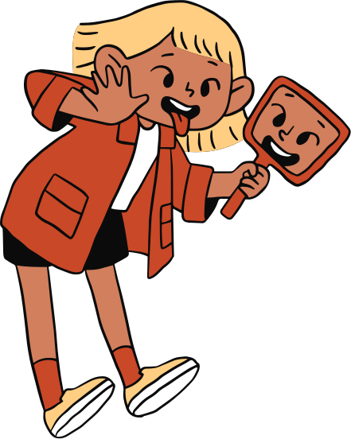

IMPORTANCE

Slide 8
facilitate the administrators to keep an eye on the library department’s all functions. Also, it enables librarians and users to save time on daunting tasks and enhances efficiency. By using this sort of library management system, the school management would be able to follow the work outline and fineness of different librarians capabilities. Additionally, they get an opportunity to know how well-maintained the record of issued books and collection is. The
librarian and the administration department can access various reports to
implement new improvements.
Thus, the efficient library management software is essential to run smart
school functions, and maintain accurate data of a library.
LIBRARY

Slide 9


TOOLS USED

Slide 10





THE TOUCH

Slide 11


DATASETS

Slide 12
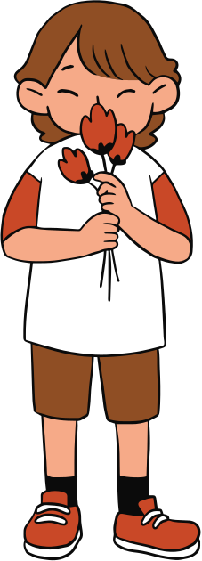
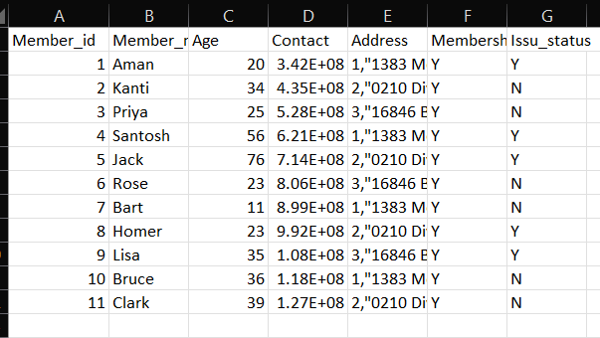
Members.csv

Slide 13
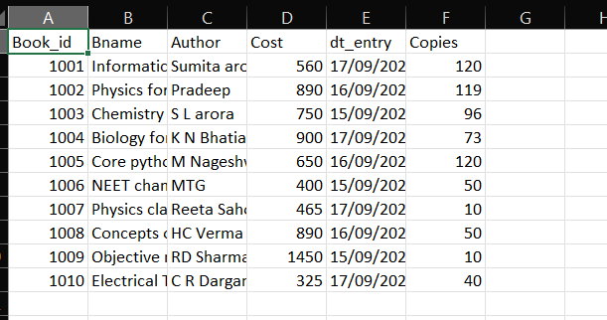
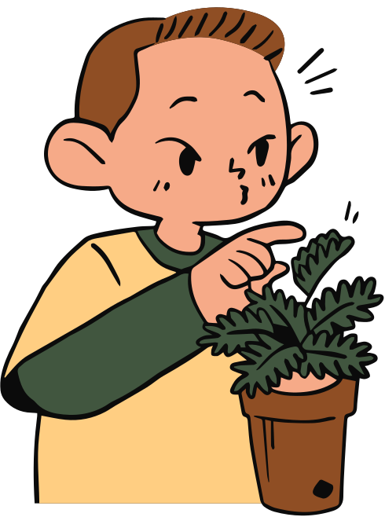
Books.csv

Slide 14
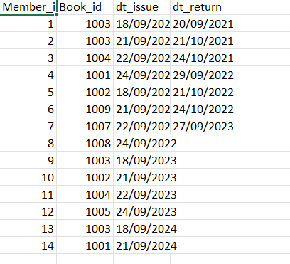
Transaction.csv

Slide 15
CODE

Slide 16
IMPORT LIBRARIES
import pandas as pd
import matplotlib.pyplot as plt
import numpy as np
global path
from datetime import date
import time
pd.set_option('display.max_columns',None)
LIBRARY

Slide 17
def menu():
while True:
print("LMS Version 1.00 By: Computer Concepts: A K Pandey")
print(" LIBRARY MANAGEMENT SYSTEM")
print(" P U B L I C L I B R A R Y")
print(" *****************************")
print()
print(" 1- BOOKS")
print(" 2- MEMBERS")
print(" 3- TRANSACTION")
print(" 4- VISUALIZATION")
print(" 5- ANALYTICS/QUERY")
print(" 6- E X I T")
ch=int(input(" Enter your choice [1-6] :"))
if ch==1:
books()
elif ch==2:
members()
elif ch==3:
transaction()
elif ch==4:
visualization()
elif ch==5:
analytics()
else:
print("Thank You")
break
def books():
while True:
print(" B O O K S M E N U")
print(" **********************")
print()
print(" 1- Add New Books")
print(" 2- Delete old Books")
print(" 3- Edit detail of the Books")
print(" 4- B A C K")
ch=int(input(" Enter your choice [1-4] :"))
if ch==1:
add_book()
elif ch==2:
del_book()
elif ch==3:
edit_book()
else:
print("Going back to Main Menu")
break

Slide 18
def members():
while True:
print(" M E M B E R S M E N U")
print(" *************************")
print()
print(" 1- Add Members")
print(" 2- Delete Members")
print(" 3- Edit detail of the Memebers")
print(" 4- B A C K")
ch=int(input(" Enter your choice [1-4] :"))
if ch==1:
add_member()
elif ch==2:
del_member()
elif ch==3:
edit_member()
else:
print("Going back to Main Menu")
break
def transaction():
dftrans=pd.read_csv("Transaction.csv")
print(dftrans)
while True:
print(" T R A N S A C T I O N M E N U")
print(" **********************************")
print()
print(" 1- Issue a Book")
print(" 2- Return a Book")
print(" 3- B A C K")
ch=int(input(" Enter your choice [1-3] :"))
if ch==1:
issue_book()
elif ch==2:
return_book()
else:
print("Going back to Main Menu")
break

Slide 19
def add_book():
dfbooks=pd.read_csv("Books.csv")
ans='y'
bid=0
while ans=='y' or ans=='Y':
df=dfbooks.sort_values(by='Book_id')
df=df.tail(1)
bid=df.iloc[0,0]+1
#bid=int(input("Enter Book id :"))
print("New Book id : ",bid)
bnm=input("Enter Book Name :")
auth=input("Enter Author Name :")
price=float(input("Enter Price :"))
dt_enter=input("Enter Date of Entry :")
cpy=int(input("Enter No. of copies:"))
data=[bid,bnm,auth,price,dt_enter,cpy]
dfbooks.loc[len(dfbooks)]=data
dfbooks.to_csv("Books.csv",index=False)
print("A New Books added Successfully....")
ans=input("Do you want to add more books?")
print(dfbooks)
def del_book():
dfbooks=pd.read_csv("Books.csv")
ans='y'
bid=0
while ans=='y' or ans=='Y':
bid=int(input("Enter Book id :"))
if bid in dfbooks['Book_id'].values:
response=input("Do you really want to remove this book from Library(Y/N)?")
if response=='y' or response=='Y':
dfbooks.drop(dfbooks[dfbooks['Book_id']==bid].index,inplace=True)
print("Book id -",bid,"has been deleted successfully...")
else:
print("Book is not found...")
dfbooks.to_csv("Books.csv",index=False)
ans=input("Do you want to delete more books?")
print(ans)

Slide 20
def edit_book():
dfbooks=pd.read_csv("Books.csv")
print(dfbooks)
ans='y'
bid=0
while ans=='y' or ans=='Y':
bid=int(input("Enter Book id :"))
if bid in dfbooks['Book_id'].values:
nm=input("Enter the column name to change: ")
val1=eval(input("Enter it's value: if string in quotes(''): "))
dfbooks.loc[(dfbooks['Book_id'] == bid),nm]=val1
print("Book id -",bid,"has been updated successfully...")
print(dfbooks.loc[dfbooks['Book_id']==bid])
else:
print("Book is not found...")
dfbooks.to_csv("Books.csv",index=False)
ans=input("Do you want to edit more books?")
print(ans)
def add_member():
dfmembers=pd.read_csv("Members.csv")
ans='y'
mid=0
while ans=='y' or ans=='Y':
df=dfmembers.sort_values(by='Member_id')
df=df.tail(1)
mid=df.iloc[0,0]+1
print("New Member id : ",mid)
mem_nam=input("Enter Member Name :")
age=int(input("Enter Age :"))
phno=int(input("Enter Contact :"))
addr=input("Enter Address :")
mship=input("Enter Membership Status (Y/N) :")
iss_st='N'
data=[mid,mem_nam,age,phno,addr,mship,iss_st]
dfmembers.loc[len(dfmembers)]=data
dfmembers.to_csv("Members.csv",index=False)
print("A New Member added Successfully....")
ans=input("Do you want to add more Members?")
print(dfmembers)

Slide 21
def del_member():
dfmembers=pd.read_csv("Members.csv")
ans='y'
mid=0
while ans=='y' or ans=='Y':
mid=int(input("Enter Member id :"))
if mid in dfmembers['Member_id'].values:
print(dfmembers.loc[dfmembers.Member_id==mid,['Member_name','Age']])
ans=input("Do you want to really delete it(Y/N)")
if ans=='y' or ans=='Y':
dfmembers.drop(dfmembers[dfmembers['Member_id']==mid].index,inplace= True)
print("Member id -",mid,"has been deleted successfully...")
else:
print("Member is not found...")
dfmembers.to_csv("Members.csv",index=False)
ans=input("Do you want to delete more members?")
print(dfmembers)
def edit_member():
dfmembers=pd.read_csv("Members.csv")
print(dfmembers)
ans='y'
mid=0
while ans=='y' or ans=='Y':
mid=int(input("Enter Member id :"))
if mid in dfmembers['Member_id'].values:
nm=input("Enter the column name to change: ")
val1=eval(input("Enter it's value: if string in quotes(''): "))
dfmembers.loc[(dfmembers['Member_id'] == mid),nm]=val1
print("Member id -",mid,"has been updated successfully...")
print(dfmembers.loc[dfmembers['Member_id']==mid])
else:
print("Member is not found...")
dfmembers.to_csv("Members.csv",index=False)
ans=input("Do you want to edit more Members?")
print(dfmembers)

Slide 22
def issue_book():
dfbooks=pd.read_csv("Books.csv")
dfmembers=pd.read_csv("Members.csv")
dftrans=pd.read_csv("Transaction.csv")
ans='y'
while ans=='y' or ans=='Y':
mid=int(input("Enter Member id: "))
bid=int(input("Enter Book id to be issued: "))
if mid in dfmembers['Member_id'].values:
print(dfmembers.loc[dfmembers.Member_id==mid,['Member_name','Age']])
mship=dfmembers.loc[dfmembers['Member_id'] == mid,'Membership'].values[0]
istatus=dfmembers.loc[dfmembers['Member_id'] == mid,'Issu_status'].values[0]
if (mship=='y' or mship=='Y') and (istatus=='n' or istatus=='N'):
if bid in dfbooks['Book_id'].values:
print(dfbooks.loc[dfbooks.Book_id==bid,['Bname','Copies']])
cpy=dfbooks.loc[dfbooks['Book_id'] == bid, 'Copies'].values[0]
if cpy>0:
dt_iss=input("Please Enter date of Issue(dd/mm/yyyy): ")
data=[mid,bid,dt_iss,np.NaN]
dftrans.loc[len(dftrans)]=data
dfmembers.loc[dfmembers.Member_id == mid,'Issu_status']='Y'
dfbooks.loc[dfbooks.Book_id == bid, 'Copies']-=1
print("Book Issued Successfully...")
else:
print("Sorry ! No. of copy is insufficent in the Library..")
else:
print("Book is not found...")
else:
print("Sorry! Membership Expired!! or 1-Book Already issued. First return it..")
else:
print("Member is not found...")
dftrans.to_csv("Transaction.csv",index=False)
dfbooks.to_csv("Books.csv",index=False)
dfmembers.to_csv("Members.csv",index=False)
ans=input("Do you want to issue more books?")
print(dftrans)
def return_book():
dfbooks=pd.read_csv("Books.csv")
dfmembers=pd.read_csv("Members.csv")
dftrans=pd.read_csv("Transaction.csv")
ans='y'
while ans=='y' or ans=='Y':
mid=int(input("Enter Member id: "))
if mid in dftrans['Member_id'].values:
dt_is=input("Date of Issue: ")
dt_rtn=input("Enter Date of Return: ")
bid=dftrans.loc[(dftrans['Member_id'] == mid) & (dftrans['dt_issue'] == dt_is ), 'Book_id'].values[0]
cond=(dfmembers.Member_id==mid) & (dfmembers.Issu_status=='Y')
if cond.any():
dftrans.loc[(dftrans['Member_id'] == mid) & (dftrans['dt_issue'] == dt_is ), 'dt_return']=dt_rtn
dfmembers.loc[dfmembers.Member_id == mid, 'Issu_status']='N'
dfbooks.loc[dfbooks.Book_id == bid, 'Copies']+=1
# Calculating Fine
yyr=int(dt_rtn[6:])
mmr=int(dt_rtn[3:5])
ddr=int(dt_rtn[:2])
yyi=int(dt_is[6:])
mmi=int(dt_is[3:5])
ddi=int(dt_is[:2])
d0 = date(yyi, mmi, ddi)
d1 = date(yyr, mmr, ddr)
delta = d1 - d0
n=delta.days
if n>7:
fine=(n-7)*10.00
else:
fine=0.00
print("Please Pay Fine Rs.",fine)
print("Book Returned Successfully...")
else:
print("The book is already returned.. Action denied")
else:
print("Member is not found...")
dftrans.to_csv("Transaction.csv",index=False)
dfbooks.to_csv("Books.csv",index=False)
dfmembers.to_csv("Members.csv",index=False)
ans=input("Do you want to Return more books?")
print(dftrans)

Slide 23
def analytics():
dfbooks=pd.read_csv("Books.csv")
dfmembers=pd.read_csv("Members.csv")
dftrans=pd.read_csv("Transaction.csv")
while True:
print(" A N A L Y S I S M E N U")
print(" ***************************")
print()
print(" 1- All Books")
print(" 2- All Members")
print(" 3- Search Books (Code wise)")
print(" 4- Search Books (Name wise)")
print(" 5- Search Member ( Code wise)")
print(" 6- Search Member (Name wise)")
print(" 7- Books issued (Date wise)")
print(" 8- Back to Main Menu")
ch=int(input(" Enter your choice [1-8] :"))
if ch==1:
print(dfbooks)
elif ch==2:
print(dfmembers)
elif ch==3:
bcode=int(input("Please Enter Book ID: "))
print(dfbooks.loc[dfbooks.Book_id==bcode])
elif ch==4:
bnm=input("Please Enter Book Name: ")
length=len(dfbooks)
for i in range(length):
if bnm in dfbooks.Bname[i]:
print(dfbooks.Book_id[i],"--->",dfbooks.Bname[i])
elif ch==5:
mid=int(input("Please Enter Member ID: "))
print(dfmembers.loc[dfmembers.Member_id==mid])
elif ch==6:
m_nm=input("Please Enter Member Namee: ")
length=len(dfmembers)
for i in range(length):
if m_nm in dfmembers.Member_name[i]:
print(dfmembers.Member_id[i],"-- >",dfmembers.Member_name[i],"-->",dfmembers.Contact[i])
elif ch==7:
dt_iss=input("Please Enter Date of Issue: ")
print(dftrans.loc[dftrans.dt_issue==dt_iss])
else:
print("Going back to Main Menu")
break
def visualization():
dfbooks=pd.read_csv("Books.csv")
dfmembers=pd.read_csv("Members.csv")
dftrans=pd.read_csv("Transaction.csv")
while True:
print(" V I S U A L I Z A T I O N M E N U")
print(" *************************************")
print()
print(" 1- No. of Copies Balanced in the Library")
print(" 2- Members Age ( Specific Group)")
print(" 3- The Books Popularity")
print(" 4- Back to Main Menu")
ch=int(input(" Enter your choice [1-4] :"))
if ch==1:
typ=input("Graph Type [Line-L,Bar-B]:")
if typ=='L':
x1=dfbooks.Bname
y1=dfbooks.Copies
n=np.arange(len(dfbooks))
plt.plot(n, y1,color='m', linestyle='-.',linewidth=2,marker='o')
plt.xticks(n,x1,rotation=25)
elif typ=='B':
dfbooks.plot('Bname','Copies', kind='bar', color='r',rot=20)
plt.title("Plot: Book Name vs Copies",fontsize=16,color='r')
plt.xlabel("Book Name-->",fontsize=12,color='m')
plt.ylabel("No.of Copies-->",fontsize=12,color='m')
plt.grid()
plt.show()
elif ch==2:
typ=input("Graph Type [Line-L,Bar-B]:")
if typ=='L':
x1=dfmembers.Member_name
y1=dfmembers.Age
n=np.arange(len(dfmembers))
plt.plot(n, y1,color='r', linestyle='-.',linewidth=2,marker='^')
plt.xticks(n,x1,rotation=25)
elif typ=='B':
dfmembers.plot('Member_name','Age', kind='bar', color='m',rot=20)
plt.title("Plot: Member Name vs Age",fontsize=16,color='m')
plt.xlabel("Member Name-->",fontsize=12,color='b')
plt.ylabel("Age-->",fontsize=12,color='b')
plt.grid()
plt.show()
elif ch==3:
bid=list(dftrans.Book_id)
frequency = {}
for item in bid:
if item in frequency:
frequency[item] += 1
else:
frequency[item] = 1
df1=pd.DataFrame({'Book_id':list(frequency.keys()),'Rank':list(frequency.values())})
df2=pd.merge(df1,dfbooks,on='Book_id')
print(df2)
x=df2.Bname
y=df2.Rank
plt.bar(x,y,color='g',width=0.60)
plt.title("Plot: Book no vs Popularity",fontsize=16,color='g')
plt.xlabel("Book ID-->",fontsize=12,color='b')
plt.ylabel("Reading Frequency-->",fontsize=12,color='b')
plt.grid()
plt.show()
elif ch==4:
print("Going back to Main Menu.....")
break
#***************************************
# Call Main Menu
#***************************************
menu()
#**************************************

Slide 24
OUTPUT

Slide 25
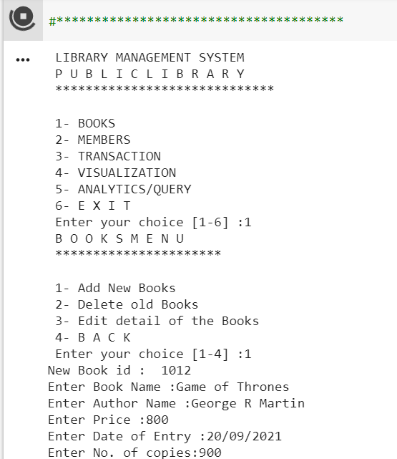
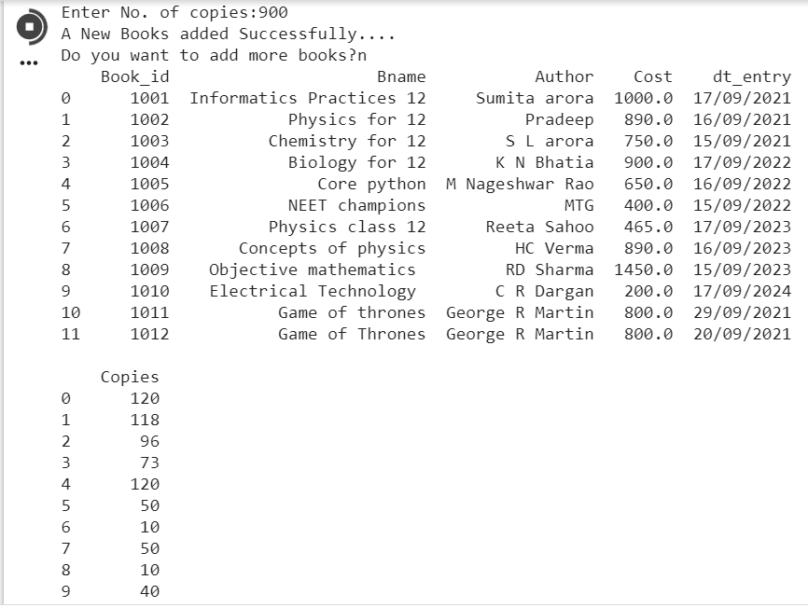

Slide 26
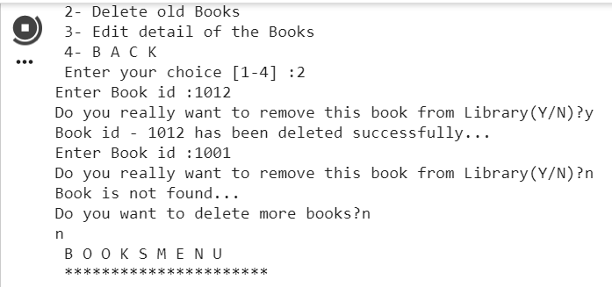
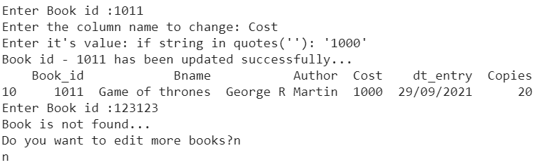

Slide 27
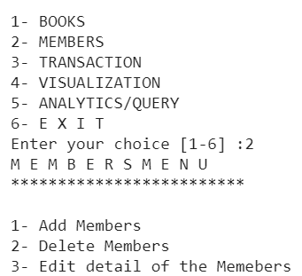
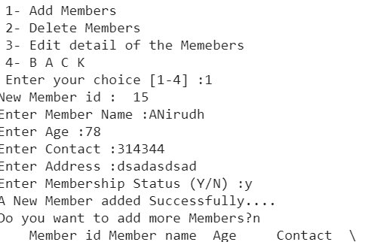
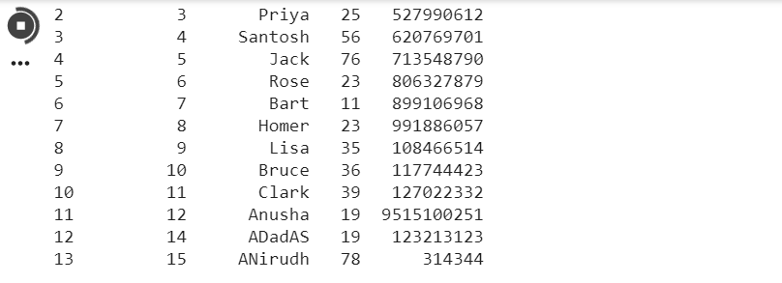

Slide 28
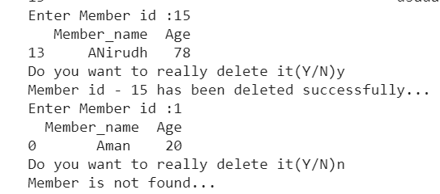
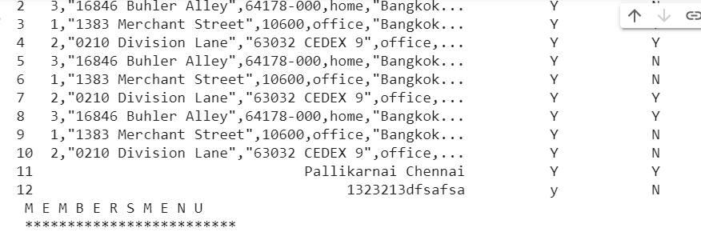
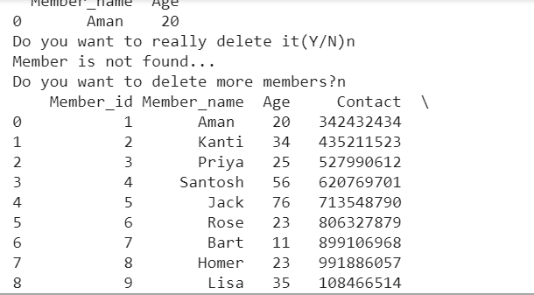

Slide 29
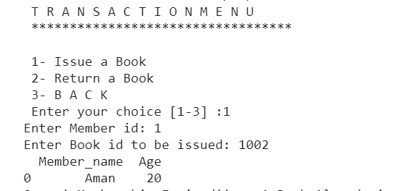
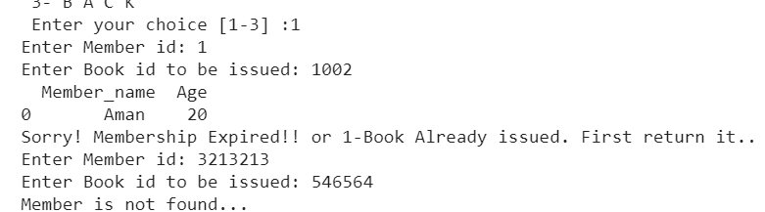

Slide 30
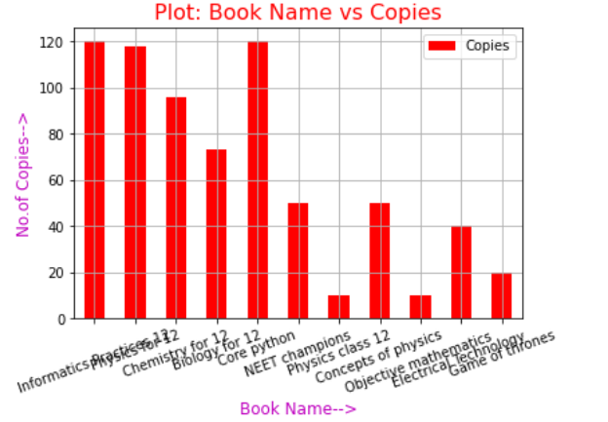
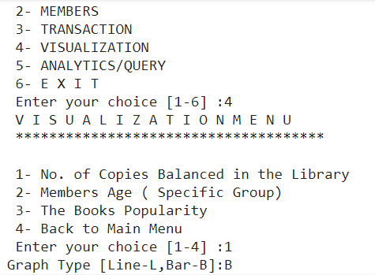

Slide 31
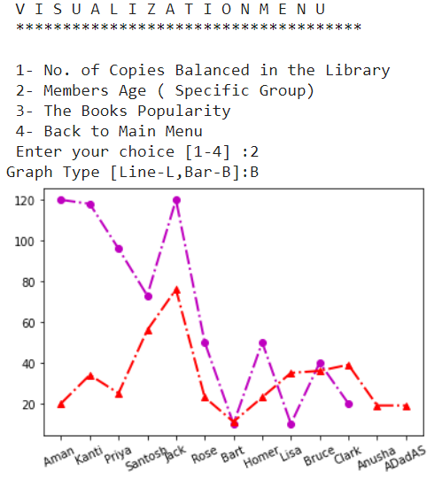
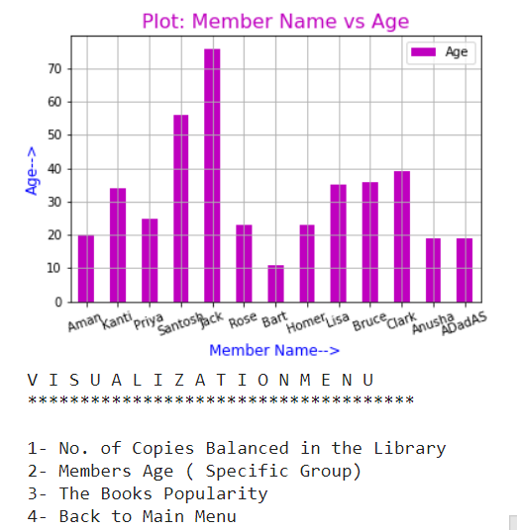

Slide 32
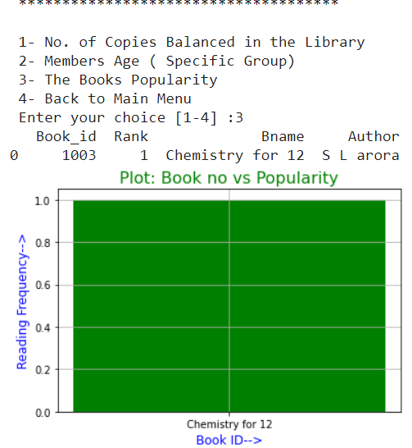
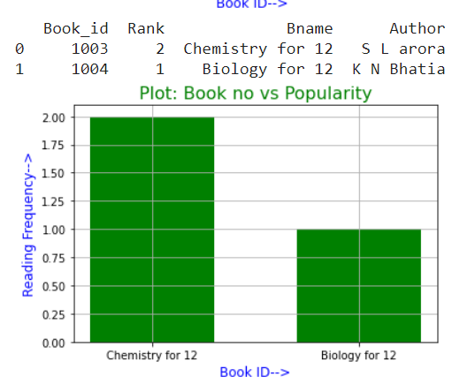
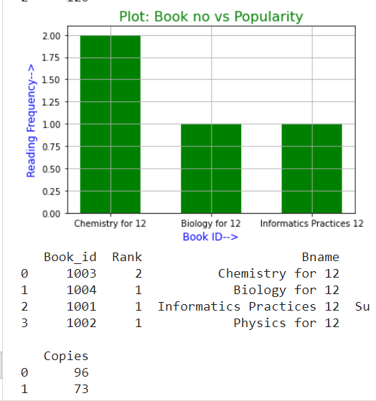

Slide 33


THANK YOU FOR LISTENING!

Slide 34
GIT HUB PROJECT PAGE LINK
https://github.com/SurvivalXUdit007/Library-Management-System.git

Slide 35
LINKEDIN PROFILE LINK
You can use these gorgeous elements to customize the slides.

Slide 36



UDIT KUMAR
Wanna be data scientist
Computer science student
Working hard towards goals
Working well against all odds

